Slide 1

深度學習智慧應用 Final Project 以蕉取量(水果產量預估)
組別:第11組
胡博智，鄭勝耀
NCTU 2021/01/12

Slide 2
OUTLINE
3. Proposed approach
2. Related work
4. Experiment results
深度學習智慧應用第11組
Final Project
1. Introduction
5. Conclusions

Slide 3
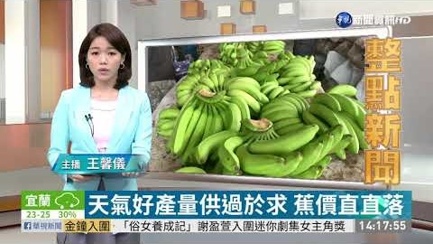
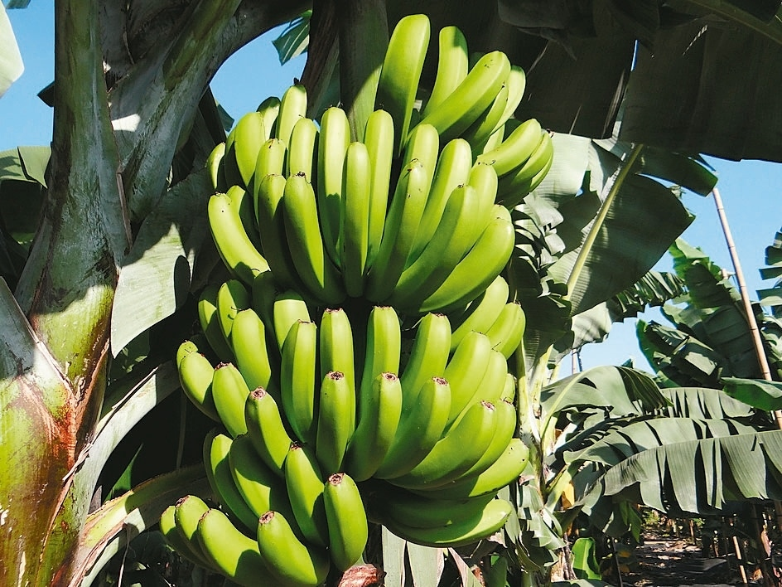
1. Introduction
要防止價格崩跌，果賤傷農
評估作物當季產量為價格預測的第一步！

Slide 4
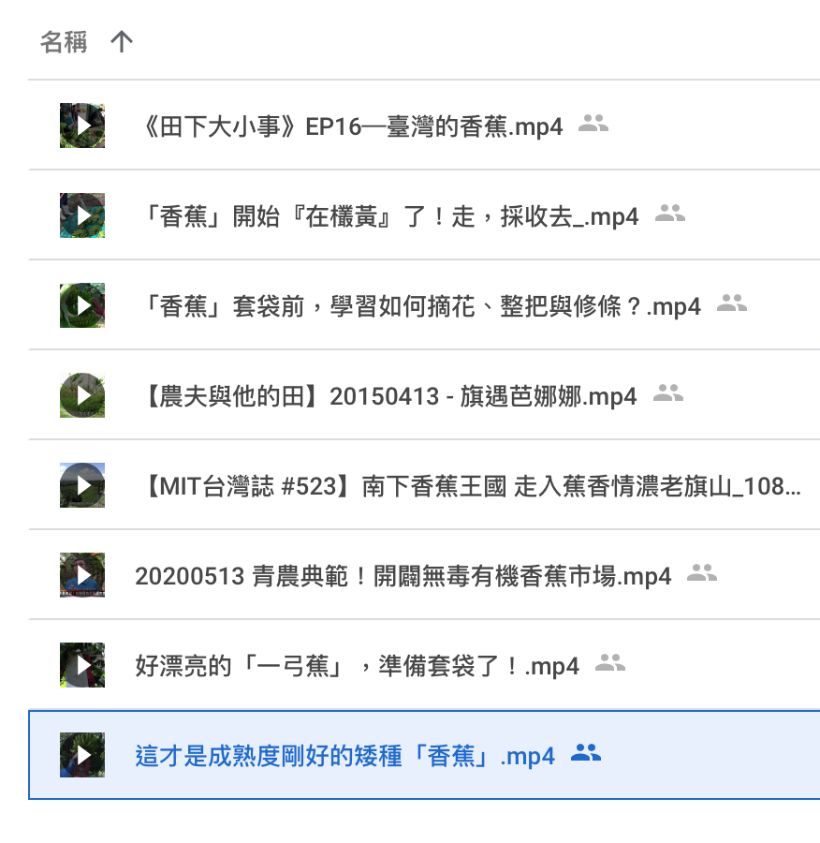
2. Related work
Dataset：
Banana Video & Picture from Internet
Split image from banana video, label about 200 for training, validation and testing
Metric：
Accuracy
Precision
Recall
F1
mAP

Slide 5
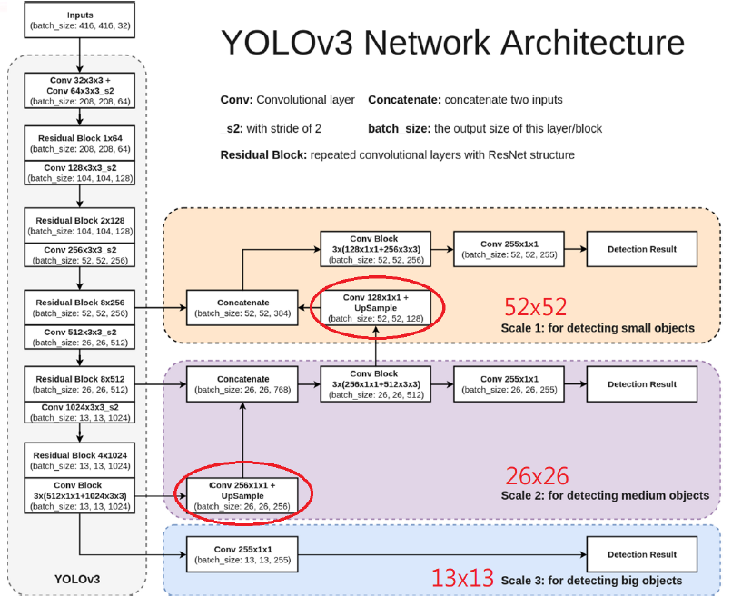
3. Proposed approach
Use YOLO v3(the same as Lab 3)

Slide 6
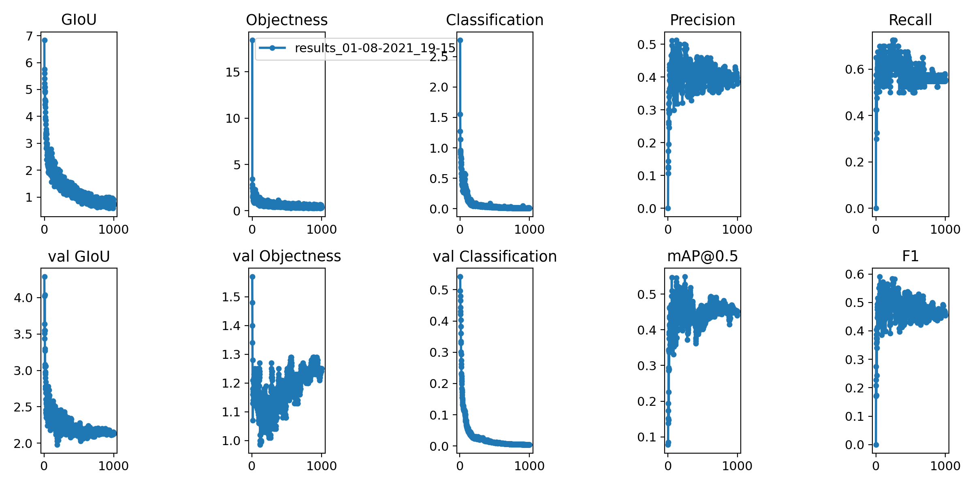
4. Experiment results
Yolov3-spp.cfg：

Slide 7
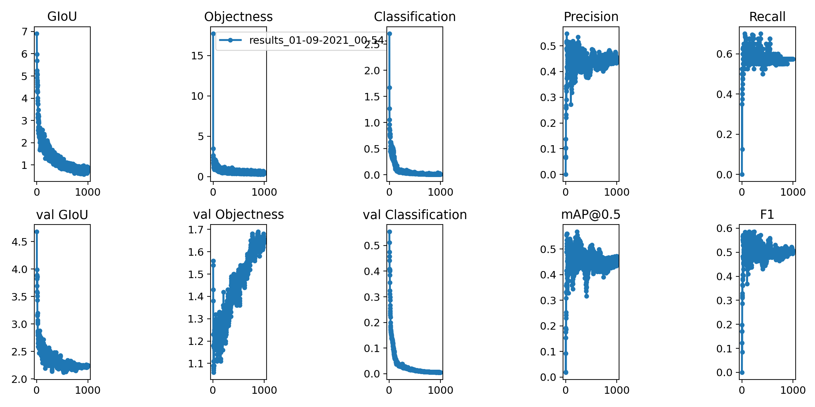
4. Experiment results
Yolov3.cfg：

Slide 8
4. Experiment results
Metric | Accuracy | Precision | Recall | F1 | mAP
Yolov3-spp.cfg | 0.508 | 0.719 | 0.634 | 0.674 | 0.359
Yolov3.cfg | 0.363 | 0.677 | 0.44 | 0.533 | 0.235
Yolov3-tiny.cfg | 0.174 | 0.576 | 0.2 | 0.297 | 0.133

Slide 9
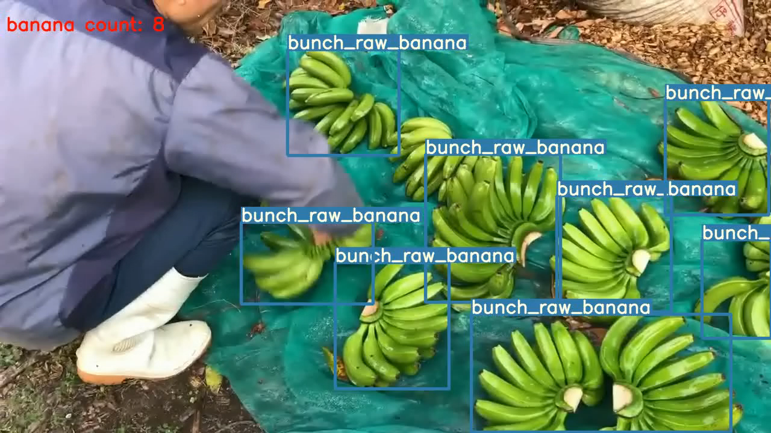
4. Experiment results
Model Video Demo：

Slide 10
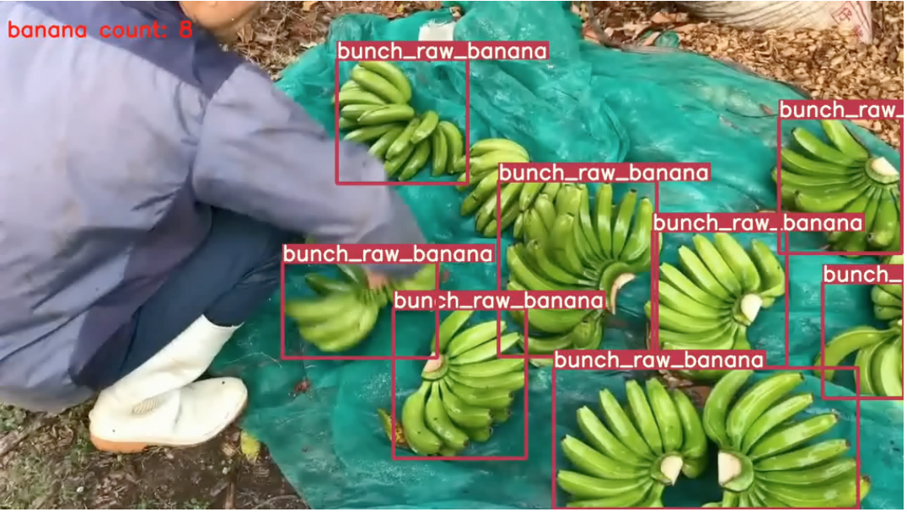
5. Conclusions
learn/found in the final project：

Slide 11
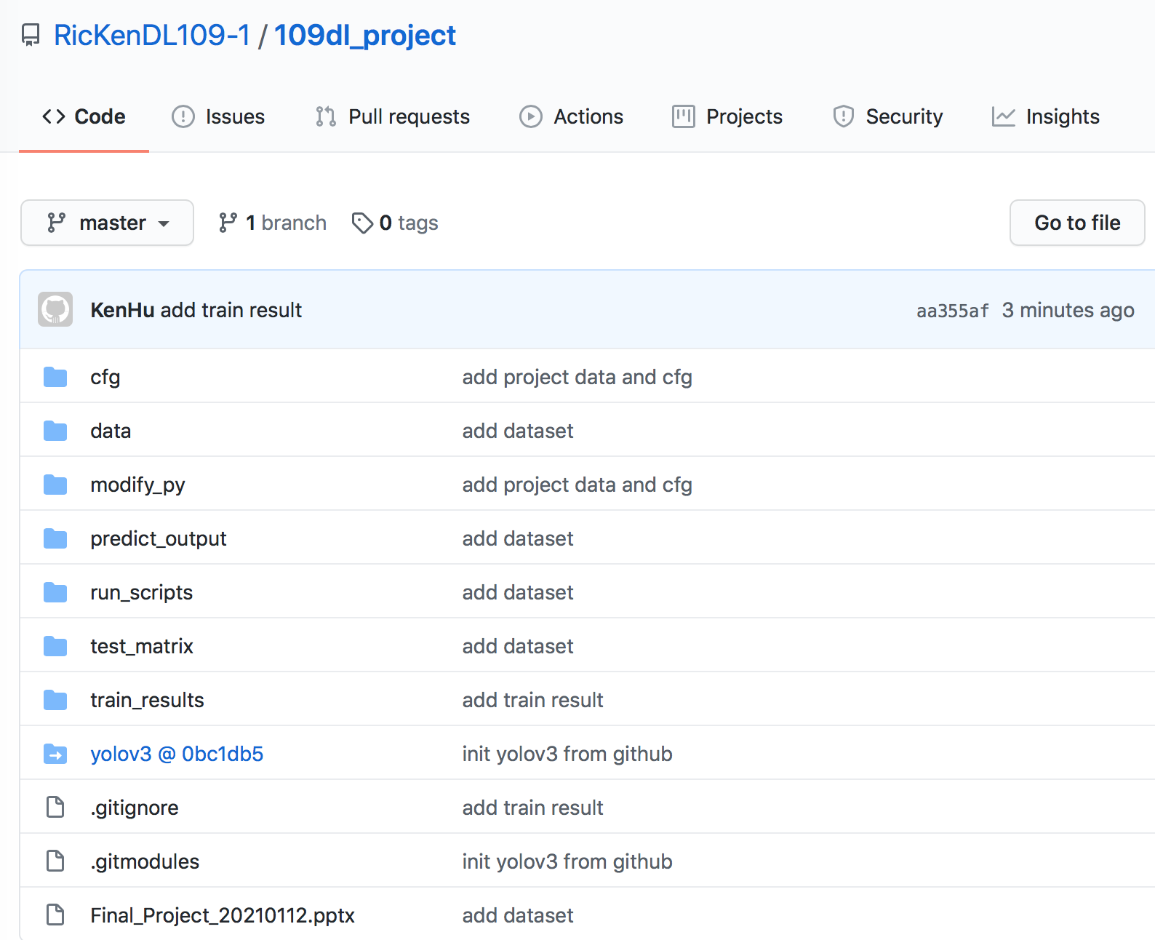
6. GitHub link
https://github.com/RicKenDL109-1/109dl_project

